Slide 1
Native Client
A Sandbox for Portable, Untrusted x86 Native Code

Slide 2
Outline
Problem
What is NaCl (Demo)
Related work
Solution
Attack Surface(First Attack Demo)
Evaluation
TUCAO

Slide 3
Before NaCl
Sum all numbers between 1 and 10000000
C
Golang
JS + V8
python
Notes:
js很好，但是问题在性能

Slide 4
What is NaCl
+
= CP
Notes:
C和js要是可以在一起，那就很好

Slide 5
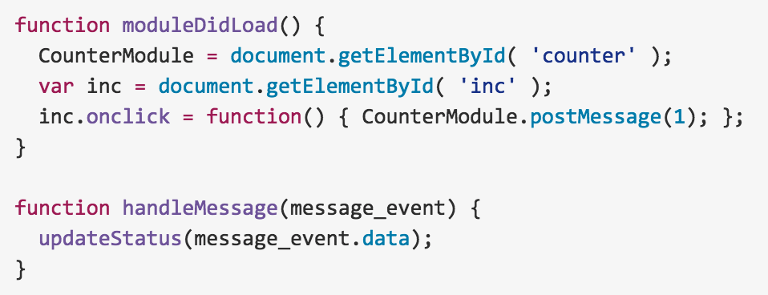
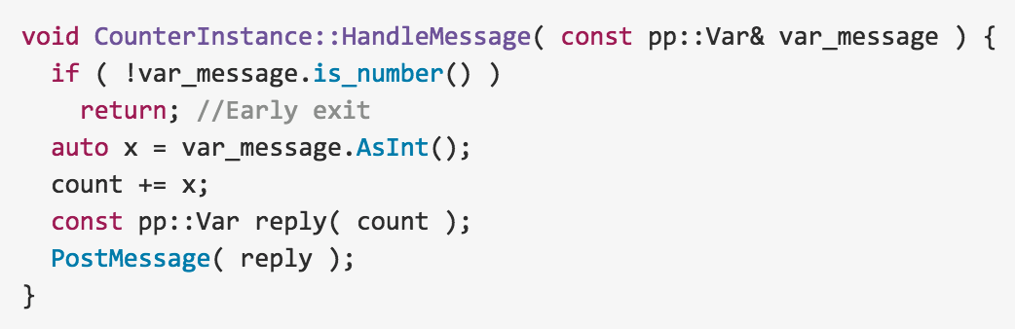
What is NaCl(Demo)
Notes:
C和js要是可以在一起，那就很好

Slide 6
What is NaCl
A sandbox for running compiled C and C++ code in the browser efficiently and securely

Slide 7
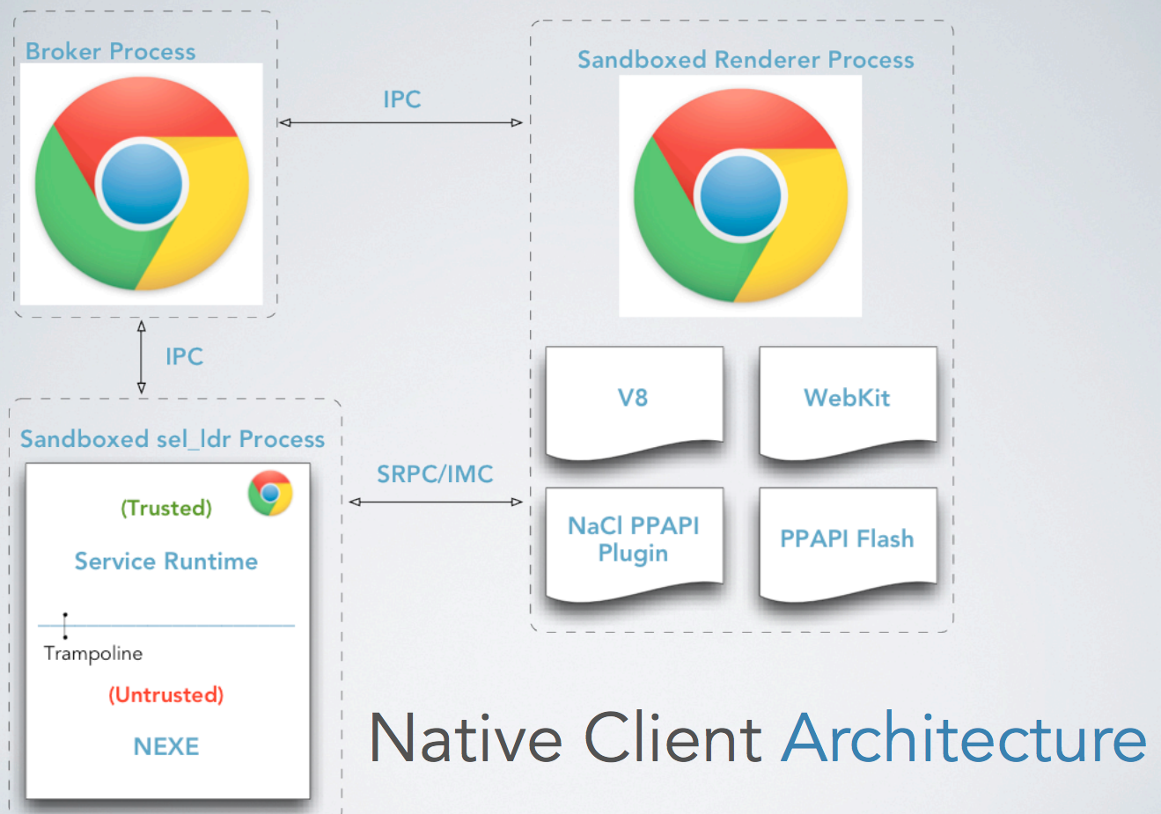
System Architecture
Notes:
JS is just traditional js
The JavaScript in turn invokes the NaCl browser plugin to load the image processing library into a NaCl container.
Service Runtime 基于操作系统提供更高的抽象
Storage Service 是另一个插件

Slide 8
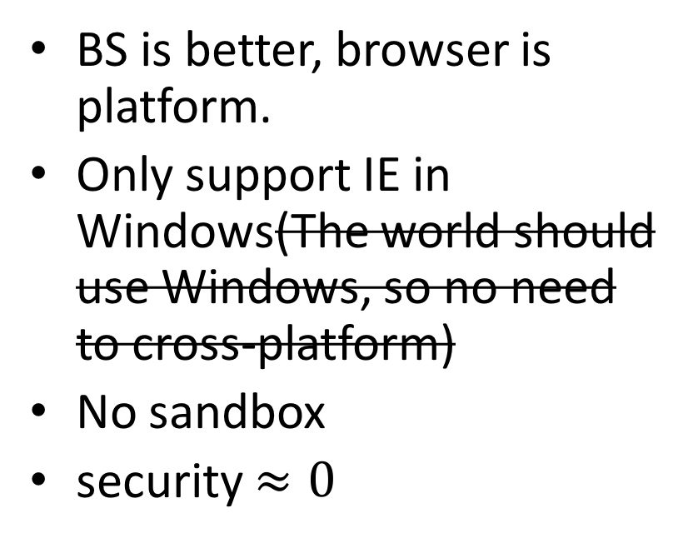
RW - ActiveX
BS is better, browser is platform.
Only support IE in Windows(The world should use Windows, so no need to cross-platform)
No sandbox
security $≈0$
Notes:
那时对浏览器的期望是很高的，业界都在鼓吹BS架构会取代CS，甚至有浏览器就是平台的极端思想。但是现实是残酷的，浏览器的表现力远远不能达到期望，功能和效率都很差。
于是业界搞出了些权宜方案，Netscape推出了NPAPI，给浏览器上打了洞，允许native代码运行，但是这个接口是很简陋的，只能用C开发，浏览器只负责加载插件，其它一切支持都没有，要插件自己搞定，作为扩展开发接口显然远远不够。

Slide 9
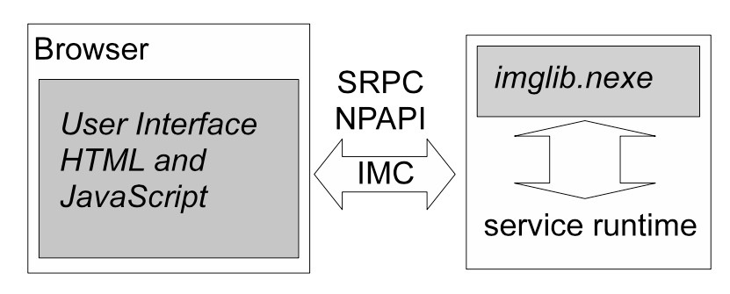
Threat Model - Sandbox
execute any reachable instruction block in the validated text segment
exercise the NaCl application binary interface to access runtime services
Notes:
IMC: send arbitrary data via our intermodule communication interface
Sandbox: execute any reachable instruction block in the validated text segment, or exercise the NaCl application binary interface to access runtime services
Service Runtime: unmoderated access to the native operating system’s system call interface

Slide 10
Threat Model - Service Runtime
unmoderated access to the native operating system’s system call interface
such as process creation, direct disk access
Notes:
IMC: send arbitrary data via our intermodule communication interface
Sandbox: execute any reachable instruction block in the validated text segment, or exercise the NaCl application binary interface to access runtime services
Service Runtime: unmoderated access to the native operating system’s system call interface

Slide 11
Threat Model - IMC
send arbitrary data via our intermodule communication interface
Notes:
IMC: send arbitrary data via our intermodule communication interface
Sandbox: execute any reachable instruction block in the validated text segment, or exercise the NaCl application binary interface to access runtime services
Service Runtime: unmoderated access to the native operating system’s system call interface

Slide 12
Solution - Sandbox in Sandbox
Outer Sandbox & Inner Sandbox
Outer Sandbox:
If inner sandbox compromised, the state of service runtime is accessed
Thwart behaviors by moderating system calls at process boundary

Slide 13
RW - System Request Moderation
ptrace
systrace
Notes:
NaCl内层沙盒很厉害
ptrace很多OJ网站在用它来做隔离

Slide 14
Solution - Inner Sandbox
Problem
Data integrity: no loads or stores outside of data sandbox
Reliable disassembly
No unsafe instructions
Control flow integrity
uses static analysis to detect security defects in untrusted x86 code

Slide 15
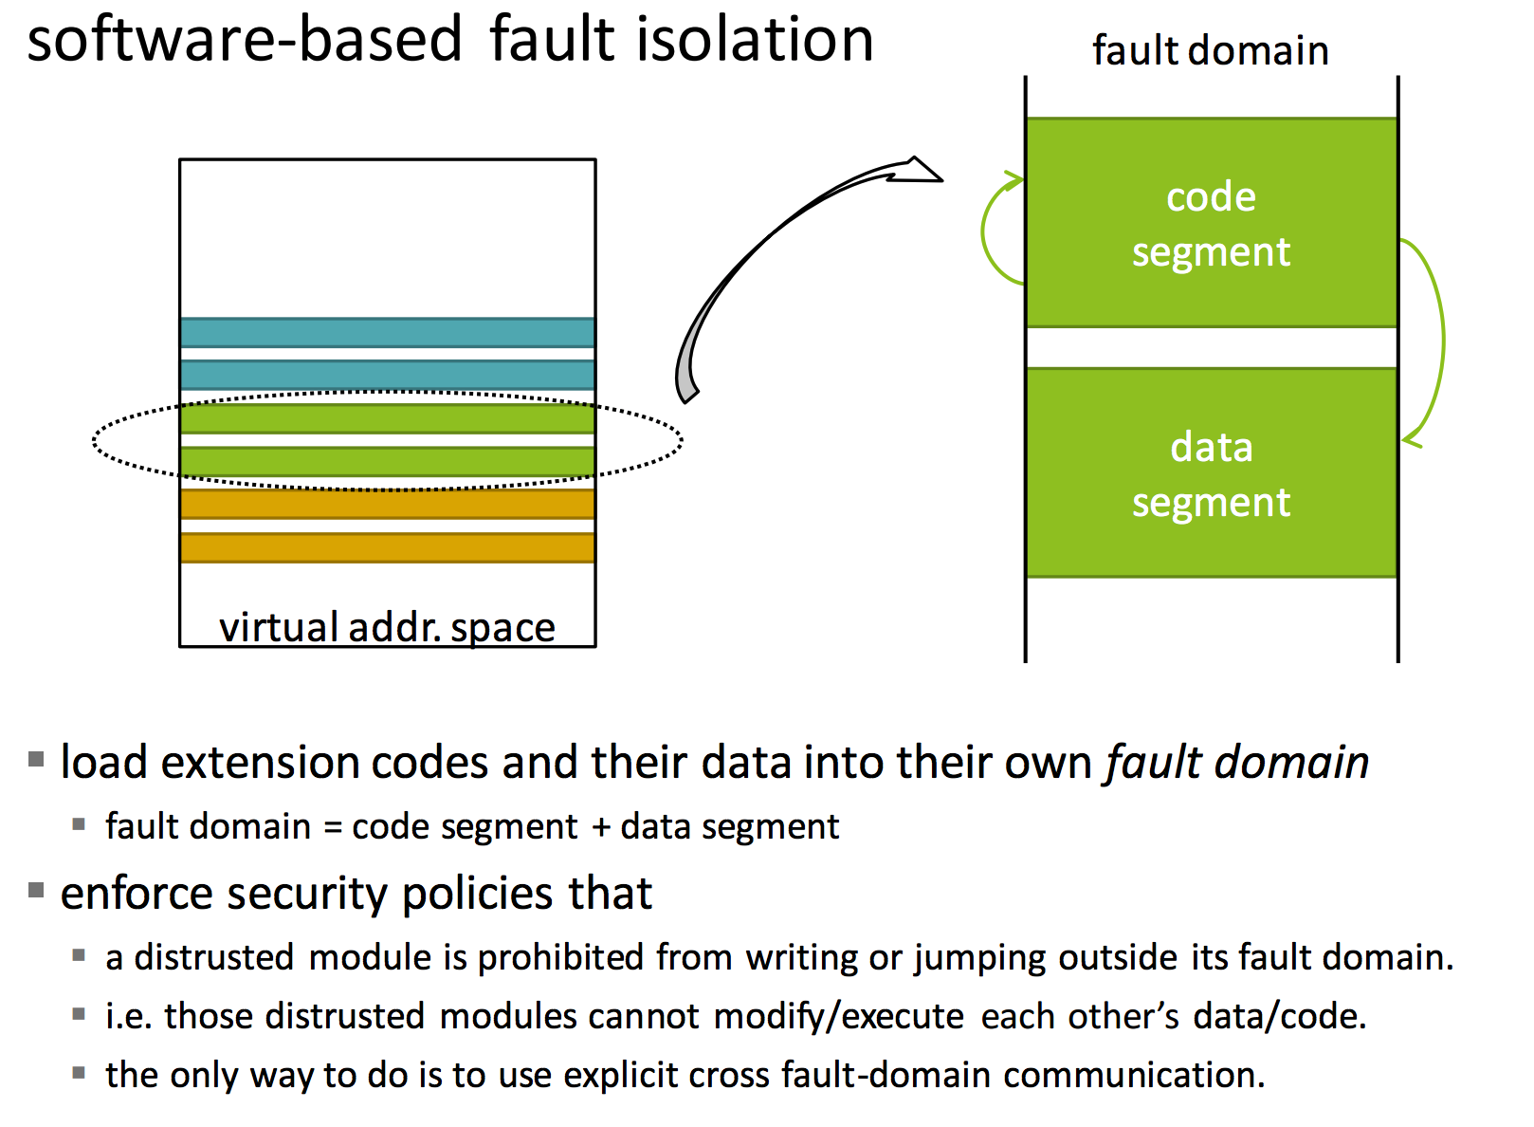
RW - Software Fault Isolation
From cs.umd.edu

Slide 16
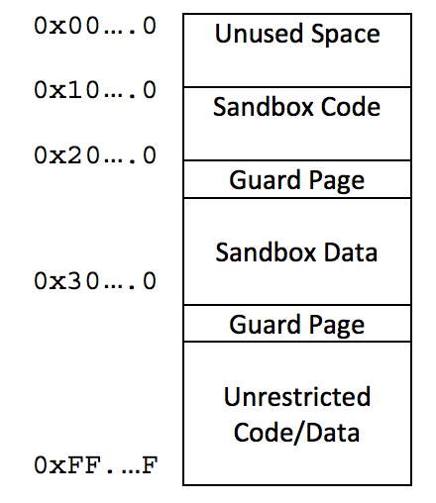
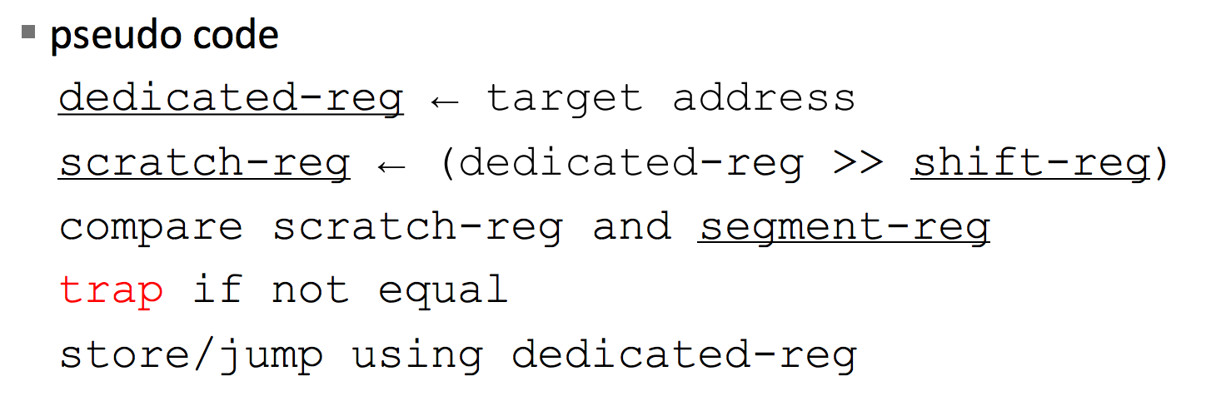
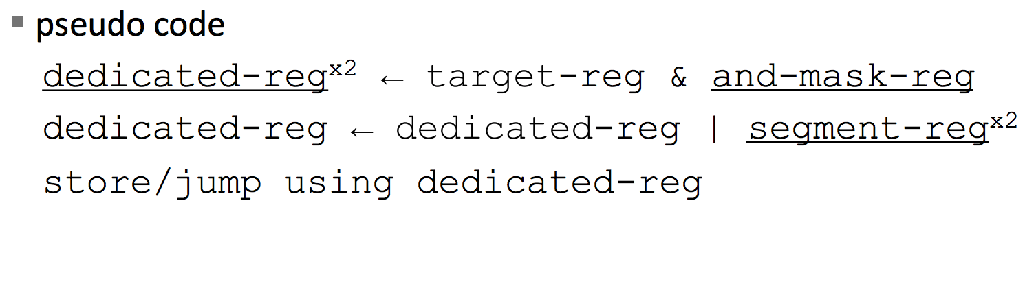
RW - Software Fault Isolation
Segment Matching
Address Sandboxing
From cs.umd.edu
Notes:
两种做法，segment matching和address sandboxing，第一种可以发现错误，第二种只能保证正确但是性能好。
NaCl是第二种，但是做了优化，就是通过zero based text把第二步的or操作优化没了。。

Slide 17
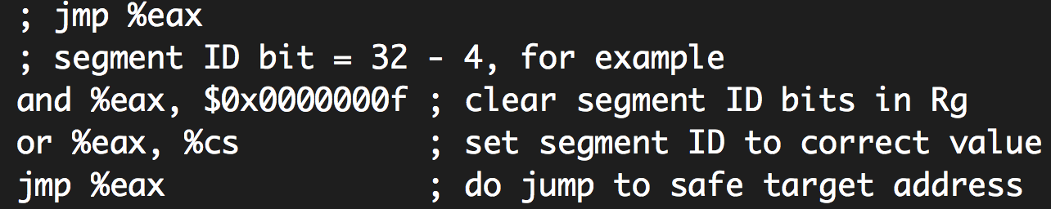
RW - Software Fault Isolation
Address Sandboxing
Notes:
两种做法，segment matching和address sandboxing，第一种可以发现错误，第二种只能保证正确但是性能好。
NaCl是第二种，但是做了优化，就是通过zero based text把第二步的or操作优化没了。。

Slide 18
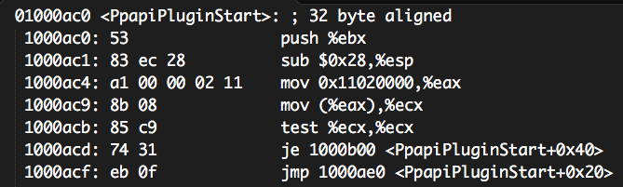
Solution - Inner Sandbox
No instructions can straddle the 32 byte boundary
Branches are used to transfer control across boundaries
No ret instructions, the stack is manually modified

Slide 19
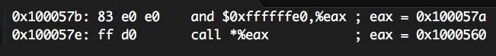
Solution - Inner Sandbox
Branch instructions are properly aligned to validated code
call instructions are subject to a simple AND operation
Alignment masking on the destination register ensures a 32 byte alignment which guarantees the destination has been run through the validator
Prevents over written NEXE function pointers and modified registers from resulting in arbitrary code execution
No OR operation compared with former research

Slide 20
Static Analysis
Pros
No need to trust compiler, a small TCB(600 : 73000000)
No runtime overhead
Cons
Not accurate
A hacker could modify binary

Slide 21
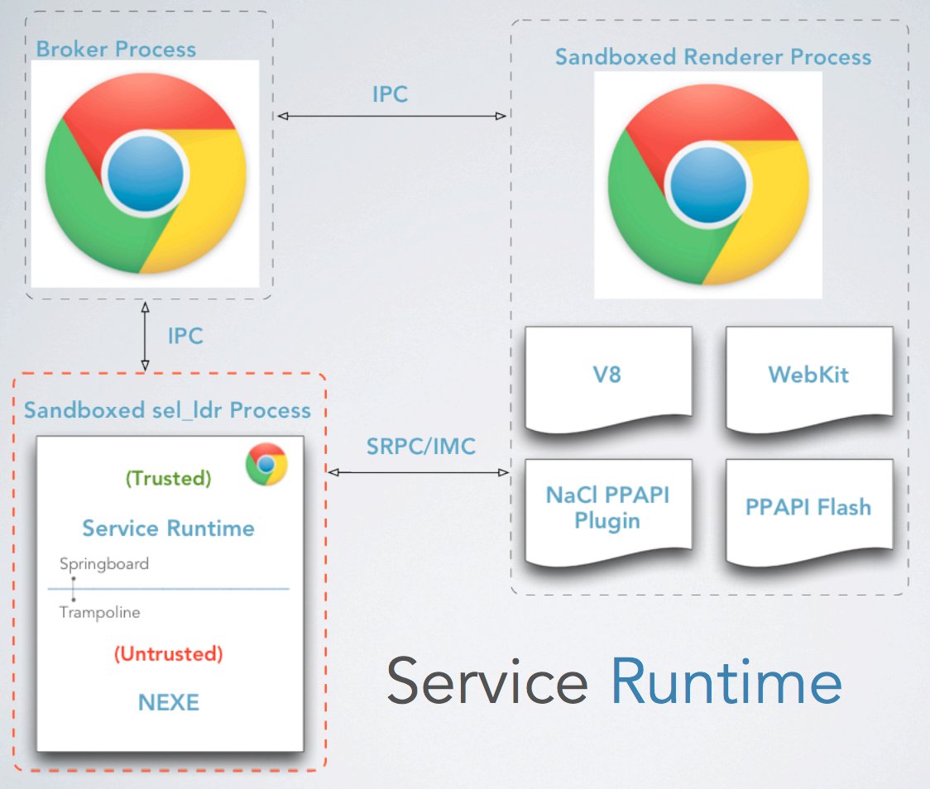
Solution - Service Runtime
Stand alone process, launched from Chrome
Runs in the same sandbox as Chrome renderer Outer Sandbox

Slide 22
Solution - Service Runtime
Trusted instruction blocks are mapped at runtime to enable a context switch between trusted and untrusted
Springboard enable trusted to untrusted
Trampolines enable untrusted to trusted
Each contain privileged instructions that manipulate the segment registers
x86 Segment Registers
Used to separate trusted from untrusted code/data
Modified when switching between trusted/untrusted
%cs code
%ds data
%gs thread local storage
%ss %es %fs

Slide 23
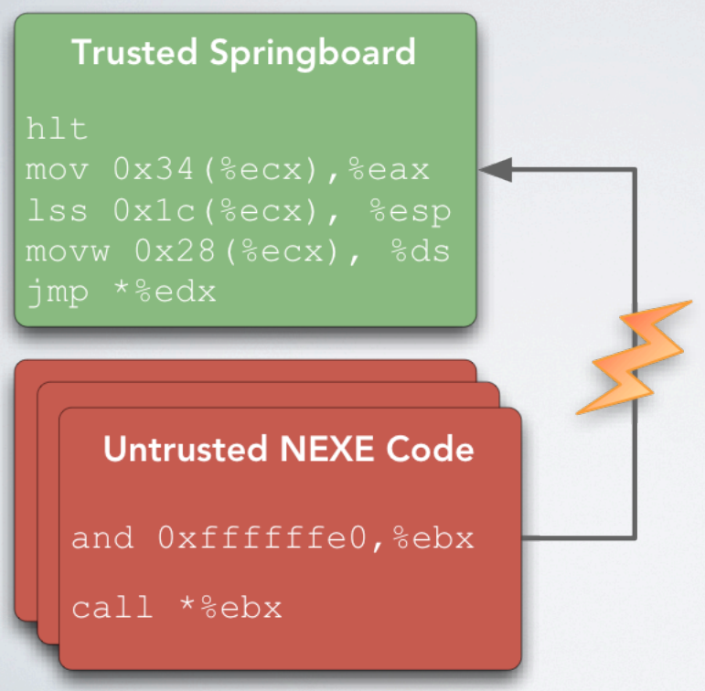
Solution - Service Runtime
Untrusted Code couldn’t jump into trusted code because of hlt and 32-byte align.

Slide 24
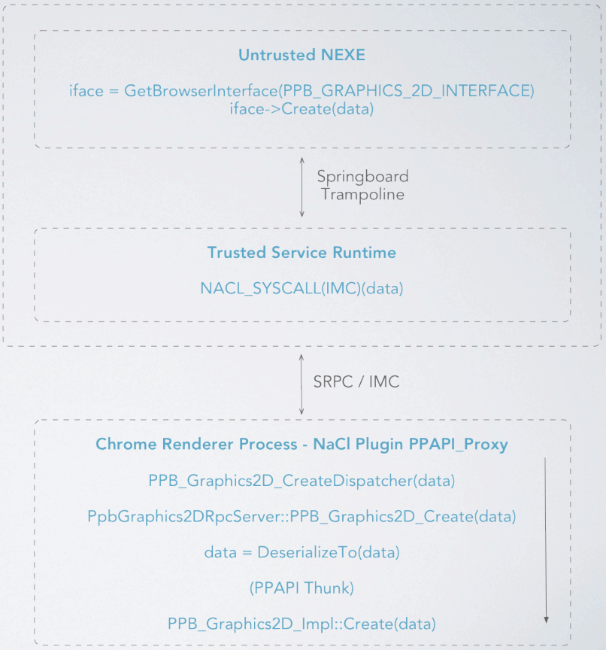
Solution - IMC
NaCl socket
bi-directional
similar to Unix domain socket
NaCl descriptor
SRPC abstraction
in untrusted code
few basic types
NPAPI implementation

Slide 25
Attack Surface
inner sandbox: binary validation
outer sandbox: OS system-call interception
service runtime binary module loader
service runtime trampoline interfaces
IMC communications interface
NPAPI interface

Slide 26
First Attack
andl $0xffffffe0, %edx
call *(%edx)
The validator and branch alignment ensure the value in the register is 32 byte aligned but not the value it references
Results in execution of a non-validated instruction
Discovered by Alex Radocea

Slide 27
2009 Native Client Security Contest
Native Client Security Contest: The results are in!
Uncovered 20 new security vulnerabilities in NaCl
Nothing that significantly broke the inner sandbox design

Slide 28
Additional Work
Modify GNU toolchain

Slide 29
Evaluation
SPEC2000
Compute/Graphics Performance Tests
H.264 Decoder
Bullet

Slide 30
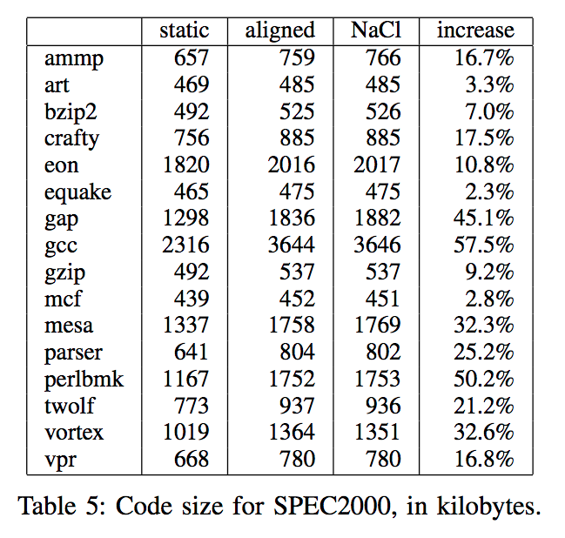
SPEC2000

Slide 31
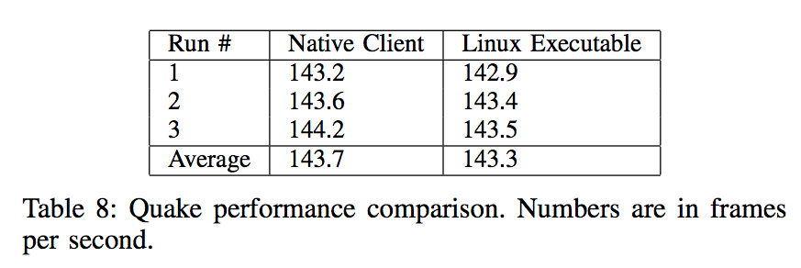
QUAKE

Slide 32
TUCAO
JavaScript is eating the world now.
ChromeOS + Native Client
Asm.js is an alternative

Slide 33
Asm.js

